Slide 1





Module 02-Python basic types
WWW.SELACLOUD.COM

Slide 2

Agenda
Memory
Variables
Python data types
Names of Python identifiers
Boolean and Numeric Variables
Basic Numeric Operators
Math — Mathematical functions
Strings Variables
String Operators and Built-in Methods
Combine Statements
Python Sequences

Slide 3
Agenda
Python Lists, Operators and Methods
Iterating Lists and lists comprehension
Python Tuple
Python Dictionary
Iterating Through a Dictionary and dictionary comprehension
Python Set
Data Type Conversion
Mutable vs Immutable in Python

Slide 4
Memory
The computer memory is composed of a long list of bits (0 and 1)
Bits are grouped into bytes (8 bits) and words (4 bytes, 8 on 64 bit systems)
Every byte is numbered sequentially
This number is called an address
Notes:
8 consecutive bits make a larger unit of memory - a byte. A byte is the smallest unit of memory having an address (In other words, 8 bits share the same address).
One byte can contain 256 (2⁸) different combinations of 0's and 1's.
Those 256 combinations may be interpreted either as a representation of a number in the range of 0 to 255, or of a number in the range of -128 to 127, depending on type of definition (will be explained shortly).
Similarly, two consecutive bytes (16 consecutive bits) can contain 65536 (2¹⁶) different combinations of 0's and 1's.
Each of these representations can be interpreted either as a number in the range of 0 to 65535, or a number in the range of -32768 to 32767, depending on type of definition (will be explained shortly).
For further reading:
http://www.howstuffworks.com/computer-memory.htm/printable

Slide 5
Variables
Variable location in the computer s memory that has:
A name reference to memory address)
Holds a value
Has a type according to its value
Python is a dynamically typed language no need to declare variable types like in Java or C
Python - dynamic typing we can reassign variable to different data types [Java is statically typed] be careful !!!
Python variables are references to objects everything in Python is an object
Variables are local by default --[print(locals()]
Check type of a variable: type (var_name)
Notes:
8 consecutive bits make a larger unit of memory - a byte. A byte is the smallest unit of memory having an address (In other words, 8 bits share the same address).
One byte can contain 256 (2⁸) different combinations of 0's and 1's.
Those 256 combinations may be interpreted either as a representation of a number in the range of 0 to 255, or of a number in the range of -128 to 127, depending on type of definition (will be explained shortly).
Similarly, two consecutive bytes (16 consecutive bits) can contain 65536 (2¹⁶) different combinations of 0's and 1's.
Each of these representations can be interpreted either as a number in the range of 0 to 65535, or a number in the range of -32768 to 32767, depending on type of definition (will be explained shortly).
For further reading:
http://www.howstuffworks.com/computer-memory.htm/printable

Slide 6
Python data types
Python is dynamic language, so you don't need to declare your variables
Variables must be assign before we can use them
Python built-in types:
Boolean
None
Numeric types
Integers - equivalent to C longs
float: Floating-Point numbers, equivalent to C doubles
complex: Complex Number
Sequences:
String
List
Tuple
Set
Dictionary
Notes:
8 consecutive bits make a larger unit of memory - a byte. A byte is the smallest unit of memory having an address (In other words, 8 bits share the same address).
One byte can contain 256 (2⁸) different combinations of 0's and 1's.
Those 256 combinations may be interpreted either as a representation of a number in the range of 0 to 255, or of a number in the range of -128 to 127, depending on type of definition (will be explained shortly).
Similarly, two consecutive bytes (16 consecutive bits) can contain 65536 (2¹⁶) different combinations of 0's and 1's.
Each of these representations can be interpreted either as a number in the range of 0 to 65535, or a number in the range of -32768 to 32767, depending on type of definition (will be explained shortly).
For further reading:
http://www.howstuffworks.com/computer-memory.htm/printable

Slide 7
Python data types – cont’d
10, -78, 0x5A, 0567
3.14j, -0.6545+0J, 4.53e-7j
0.5, -77.99, 12.3+e45
{‘a’:3}
0,1, True, False
{1,2,3}
“abc”, ‘xyz’
[1,’a’, 7.8]
(1, ’a’, 7.8)
Notes:
8 consecutive bits make a larger unit of memory - a byte. A byte is the smallest unit of memory having an address (In other words, 8 bits share the same address).
One byte can contain 256 (2⁸) different combinations of 0's and 1's.
Those 256 combinations may be interpreted either as a representation of a number in the range of 0 to 255, or of a number in the range of -128 to 127, depending on type of definition (will be explained shortly).
Similarly, two consecutive bytes (16 consecutive bits) can contain 65536 (2¹⁶) different combinations of 0's and 1's.
Each of these representations can be interpreted either as a number in the range of 0 to 65535, or a number in the range of -32768 to 32767, depending on type of definition (will be explained shortly).
For further reading:
http://www.howstuffworks.com/computer-memory.htm/printable

Slide 8
Names of Python identifiers
Rules for a python identifiers (variable name, function, class, module):
- A identifier name may contain:
Digits ( 0 to 9 ).
Letters, both lower case and upper case ('a'-'z' and 'A'-'Z').
Underscores ('_').
- The first character must not be a digit and preferable not underscore
- It is extremely important to choose meaningful names for identifiers and not preserved python name.
- All identifier names are case-sensitive.
Notes:
There are several modes for representing numbers.
The digits (0-9) can be displayed as text. For example: We can represent the digit 3 with the character code 51 (in 0’s and 1’s, of course). We can represent the number 2.3 as 3 characters with the text values of “2”, “.” (a dot), and “7”.
There is not much point in performing arithmetic calculations on numbers that are kept in memory in this mode.
In order to perform arithmetic operations on numbers, they should be represented in one of the following modes :
Normal binary: Only whole numbers, non negative.
Two's complement binary: Only whole numbers, positive, negative and zero.
Floating point: Real numbers (whole and fractional), positive, negative and zero.
The programmer chooses the mode in which a number will be kept in the computer’s memory. You will soon see how.

Slide 9
Names of Python identifiers – cont’d
Naming convention for Python:
All identifiers should be lowercased with underscore as words separato: (sum_of_digits)
Class names start with an uppercase letter and all other identifiers, like variables and functions with a lowercase letter : `MyClass` , `PersonModel`, `CarFactory`.
Starting an identifier with a single leading underscore indicates, by convention, that the identifier is meant to be private : `_internal_variable`, `_private_method`
If the identifier starts and ends with two trailing underscores, the identifier is a language-defined special name: `__init__`, `__name__`
Notes:
Important:
In the 2's Complement Binary the leftmost bit (known as the Most Significant Bit - MSB) is the “sign bit “:
1 signifies a negative number.
0 a non-negative (positive or zero).
However, the numbers 5 and -5, for example, look very different when represented in the 2’s Complement mode. 5 looks like this : 00000101 -5 looks like this : 11111011 It is easy to see that not only the MSB is different.
As opposed to 2's Complement, in Normal Binary the most significant bit has no special significance, it is just another bit...

Slide 10


Boolean Variables and None
Boolean variables:
Boolean variables can hold only True or False values.
For example:
None value (of NoneType)
None is used to represent the absence of a value
Notes:
A variable is an address in memory holding a value.
We can think of variables in computer memory as drawers.
We can put things in drawers and take them out again.
Or, we can just look inside a drawer to see if anything is there.
The same applies to variables; we place data in them and can take it out or look at it, as required.
Note: The value held by a variable may be a reference to another variable.
Although all data in a computer is effectively the same thing (a series of zeros and ones), variables come in different flavors, known as types.
Using the drawer analogy, drawers come in different shapes and sizes, and some things will only fit in certain drawers.

Slide 11
Numeric types
In python 2.X integer can be represented by both int and long types. int is for small values (4 bytes), long have unlimited digits count.
In python 3.x there is only one integer type – int, with unlimited digits count (line long in python 2.x).
int: 123, -78, 0x5A, 0567
long: 51924361987678, 0xDEFABCECBDAECBFBAEl
float: 0.5, -77.99, 12.3+e45
complex: 3.14j, -0.6545+0J, 4.53e-7j

Slide 12
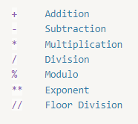

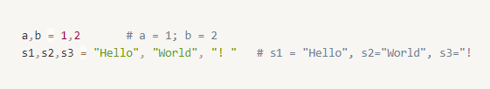
Basic Numeric Operators
Arithmetic
Assignment
Corresponding assignment (value objects count must be equal to value count)
Notes:
Let’s assume we wish to write a program that swaps the contents of two Label.
Can we do it without using a third element?
It is possible but somewhat awkward to swap two elements without another in the middle.
So we need some variable to hold the contents of the first Label save it so that we can put it into the other Label.
This is an example of the need for a variable to hold data.
We can manipulate the variable content in order to perform more complex operations.

Slide 13
Numeric Operators

Slide 14
Example 1:
Example 2:
n1 = 8 n2 = 7 res = n1+n2 * 2 # res = 22 res -= 10 #res = 12
num1 = 8; num2 = 3; num3 = 8.0 res1 = int(num1/num2) # res1 = 2 res2 = num3/num2 # res2 = 2.667 res3 = num1//num2 # res3 = 2
Notes:
Let’s assume we wish to write a program that swaps the contents of two Label.
Can we do it without using a third element?
It is possible but somewhat awkward to swap two elements without another in the middle.
So we need some variable to hold the contents of the first Label save it so that we can put it into the other Label.
This is an example of the need for a variable to hold data.
We can manipulate the variable content in order to perform more complex operations.

Slide 15

Math — Mathematical functions
We can import math module to use mathematics functions (will be discussed later in the course)
math module contains functions like: pow, sqrt, exp, log, sin, etc
To see all math definitions use:
To see the documentation about some function of math module use built-in help function:
For example:
import math num = math.sqrt(16) print(num) #prints 4
Notes:
Let’s assume we wish to write a program that swaps the contents of two Label.
Can we do it without using a third element?
It is possible but somewhat awkward to swap two elements without another in the middle.
So we need some variable to hold the contents of the first Label save it so that we can put it into the other Label.
This is an example of the need for a variable to hold data.
We can manipulate the variable content in order to perform more complex operations.

Slide 16
Python index-base Sequences
The most basic data structure in Python is a sequence.
Python has several built-in types of sequences: lists, tuples, dictionaries, sets and strings
The lists, tuples and strings are index-based sequences.
The index-based sequences are support index access and index-range access
positive and negative indexes are supported (positive indexes starts with 0, negative with -1)
A negative indexes are counted from the end. So we can access the last element is with -1 index, the second to the last element would be -2, and so on.
Notes:
Let’s assume we wish to write a program that swaps the contents of two Label.
Can we do it without using a third element?
It is possible but somewhat awkward to swap two elements without another in the middle.
So we need some variable to hold the contents of the first Label save it so that we can put it into the other Label.
This is an example of the need for a variable to hold data.
We can manipulate the variable content in order to perform more complex operations.

Slide 17
Strings Variables
Strings in Python can be created using single quotes, double quotes, and triple quotes.
Python treats single quotes and double quotes strings the same:
For example:
An escape character interpreted in both single-quoted and double-quoted strings.
s = "Hello World!" name = "Daniel Kohen"
Notes:
Let’s assume we wish to write a program that swaps the contents of two Label.
Can we do it without using a third element?
It is possible but somewhat awkward to swap two elements without another in the middle.
So we need some variable to hold the contents of the first Label save it so that we can put it into the other Label.
This is an example of the need for a variable to hold data.
We can manipulate the variable content in order to perform more complex operations.

Slide 18
Strings Variables – triple quotes strings
Triple quotes strings can span for several lines and they consist of three consecutive single or double quotes.
For example:
Or:
s = """this is a long string with several lines and escape character like tab: \t and newline: \n. the end"""
s = '''this is a long string with several lines and escape character like tab: \t and newline: \n. the end'''
Notes:
Let’s assume we wish to write a program that swaps the contents of two Label.
Can we do it without using a third element?
It is possible but somewhat awkward to swap two elements without another in the middle.
So we need some variable to hold the contents of the first Label save it so that we can put it into the other Label.
This is an example of the need for a variable to hold data.
We can manipulate the variable content in order to perform more complex operations.

Slide 19
Strings Variables – raw strings
Python can define raw strings, that blocks escape characters
Putting the r character before single, double or triple quotes string will define them as raw-string
Raw-strings are used to backslash escape characters
For example:
– double back-slash for each back-slash character
Or
path = "C:\\temp\\newDir\\file.txt"
path = r"C:\temp\newDir\file.txt"
Notes:
Let’s assume we wish to write a program that swaps the contents of two Label.
Can we do it without using a third element?
It is possible but somewhat awkward to swap two elements without another in the middle.
So we need some variable to hold the contents of the first Label save it so that we can put it into the other Label.
This is an example of the need for a variable to hold data.
We can manipulate the variable content in order to perform more complex operations.

Slide 20
String Operators
+ Concatenation
* Repetition
[] Slice
[:] Range Slice
in/not in Membership
% Format
Example :
s1 = "abc"; s2 = "defgh" res1 = s1 + s2 # res1 = "abcdefgh" res2 = s1 * 2 # res2 = "abcabc" res3 = s1[0] # res3 = "a" "bc" in s1 # returns True
Notes:
Let’s assume we wish to write a program that swaps the contents of two Label.
Can we do it without using a third element?
It is possible but somewhat awkward to swap two elements without another in the middle.
So we need some variable to hold the contents of the first Label save it so that we can put it into the other Label.
This is an example of the need for a variable to hold data.
We can manipulate the variable content in order to perform more complex operations.

Slide 21
String ranges
s = "abcdef" print(s[1:4]) # "bcd" print( s[:4]) # "abcd" print( s[1:]) # "bcdef" print( s[1:-1]) # "bcde" print( s[:]) # "abcdef" print( s[::-1]) # "fedcba" print( s[::2]) # "ace" print( s[1::2]) # "bdf"
Notes:
Let’s assume we wish to write a program that swaps the contents of two Label.
Can we do it without using a third element?
It is possible but somewhat awkward to swap two elements without another in the middle.
So we need some variable to hold the contents of the first Label save it so that we can put it into the other Label.
This is an example of the need for a variable to hold data.
We can manipulate the variable content in order to perform more complex operations.

Slide 22
String as Input
In Python, the input() function is used to read user input from the standard input (usually the keyboard). It allows the program to pause and wait for the user to enter a value or a line of text.
name = input("Enter your name: ") print("Hello, " + name + "!")
Notes:
Let’s assume we wish to write a program that swaps the contents of two Label.
Can we do it without using a third element?
It is possible but somewhat awkward to swap two elements without another in the middle.
So we need some variable to hold the contents of the first Label save it so that we can put it into the other Label.
This is an example of the need for a variable to hold data.
We can manipulate the variable content in order to perform more complex operations.

Slide 23
Immutability of strings
Python strings are immutable
Direct assignment to its items is not supported
There are a lot of functions for replacing, sub-stringing, etc. They all built and return the changed string
s = "abc" s[0] = "a" - ERROR
s = "abac" s1 = s.replace("a", "A") print("s = {}, s1 = {}".format(s, s1)) #s = "abac", s1="AbAc"
Notes:
Let’s assume we wish to write a program that swaps the contents of two Label.
Can we do it without using a third element?
It is possible but somewhat awkward to swap two elements without another in the middle.
So we need some variable to hold the contents of the first Label save it so that we can put it into the other Label.
This is an example of the need for a variable to hold data.
We can manipulate the variable content in order to perform more complex operations.

Slide 24
String Built-in Methods
There are many built-in string functions in python, here some the most common:
Case functions:
s.capitalize() - Capitalizes first letter of string
s.lower(), s.upper() - returns the lowercase /uppercase version of the string
Test functions:
s.islower(), s.isupper() - Returns true if all cased characters in string are lowercase/uppercase and false otherwise
s.isalpha(), s. isalnum(), s.isdigit(), s.isspace()... - tests if all the string characters are in correct state
s.startswith(suffix[, beg=0, end=len(string)])
s.endswith(suffix[, beg=0, end=len(string)]) - tests if the string starts/ends with the given suffix
Notes:
Let’s assume we wish to write a program that swaps the contents of two Label.
Can we do it without using a third element?
It is possible but somewhat awkward to swap two elements without another in the middle.
So we need some variable to hold the contents of the first Label save it so that we can put it into the other Label.
This is an example of the need for a variable to hold data.
We can manipulate the variable content in order to perform more complex operations.

Slide 25
String Built-in Methods

Slide 26
Example 1:
Example 2:
s = "abcd" if s.islower(): s = s.capitalize() # s = "Abcd“
if s.startswith("ab"): print( "starts with ab!") # starts with ab! if s.startswith("ab",1,len(s)): print( "starts with ab!") # prints nothing, the # condition does not match
Notes:
Let’s assume we wish to write a program that swaps the contents of two Label.
Can we do it without using a third element?
It is possible but somewhat awkward to swap two elements without another in the middle.
So we need some variable to hold the contents of the first Label save it so that we can put it into the other Label.
This is an example of the need for a variable to hold data.
We can manipulate the variable content in order to perform more complex operations.

Slide 27
String Built-in Methods – cont’d
Search and replace functions:
s. find(substr[, beg, end=len])/s.rfind - searches for substr in given string s and returns start index of the first/last appearance ,-1 if not found
s.replace(old, new[, max]) - returns a string where all/max occurrences of old have been replaced by new
Example:
s = "python string ring" sub = "ing" ind1 = s.find(sub) #ind1 = 10 ind2 = s.find(sub,12) #ind2 = 15 s = s.replace(sub, "ong", 1) #s = "python strong ring"
Notes:
Let’s assume we wish to write a program that swaps the contents of two Label.
Can we do it without using a third element?
It is possible but somewhat awkward to swap two elements without another in the middle.
So we need some variable to hold the contents of the first Label save it so that we can put it into the other Label.
This is an example of the need for a variable to hold data.
We can manipulate the variable content in order to perform more complex operations.

Slide 28
String Built-in Methods – cont’d
Mix functions:
s.count(str, [beg,end]) - Counts how many times str occurs in string
s.strip() - returns a string with whitespace removed from the start and end
s.split(str [, num]) - Splits string according to delimiter str (space if not provided) and returns list of substrings; split into at most num substrings if given
s.join(seq) - Merges (concatenates) the string representations of elements in sequence seq into a string, with separator string
Notes:
Let’s assume we wish to write a program that swaps the contents of two Label.
Can we do it without using a third element?
It is possible but somewhat awkward to swap two elements without another in the middle.
So we need some variable to hold the contents of the first Label save it so that we can put it into the other Label.
This is an example of the need for a variable to hold data.
We can manipulate the variable content in order to perform more complex operations.

Slide 29
String Built-in Methods – cont’d
Example:
s = "python+strings+example" sub = "n" cnt = s.count(sub) #cnt = 2 lst = s.split("+") #list = ["python","strings","example"] str ="-" lst = ["a","b","c","d"] str = str.join(lst) #"a-b-c-d"
Notes:
Let’s assume we wish to write a program that swaps the contents of two Label.
Can we do it without using a third element?
It is possible but somewhat awkward to swap two elements without another in the middle.
So we need some variable to hold the contents of the first Label save it so that we can put it into the other Label.
This is an example of the need for a variable to hold data.
We can manipulate the variable content in order to perform more complex operations.

Slide 30
String format function
Use format function to build formatted strings
Curly-brackets are place holders. They are zero based
n1,n2 = 4,9
print("{0} + {1} = {2}".format(n1,n2, n1+n2)) # 4 + 9 = 13 print("{1} + {0} = {2}".format(n1,n2, n1+n2)) # 9 + 4 = 13
Starting from python 2.7, the indexes can be omitted
print("{} + {} = {}".format(n1,n2, n1+n2)) # 4 + 9 = 13
The same item can have multiple references
print("{0} is {0}".format(n1) # 4 is 4
Notes:
Let’s assume we wish to write a program that swaps the contents of two Label.
Can we do it without using a third element?
It is possible but somewhat awkward to swap two elements without another in the middle.
So we need some variable to hold the contents of the first Label save it so that we can put it into the other Label.
This is an example of the need for a variable to hold data.
We can manipulate the variable content in order to perform more complex operations.

Slide 31
String format function – cont’d
Place holders can be named print("first value is {first_val}, second value is {second_val}".format( second_val=1, first_val=2)) #first value is 1, second value is 2
Width and alignment can be specified
print("{0:<20}.".format("A")) # A . print("{:^20}.".format("A")) # A . print("{:>20}.".format("A")) # A.
Floating point precision can be specified
res = 10.0/3 print("{:.2f}".format(res)) # 3.33
Notes:
Let’s assume we wish to write a program that swaps the contents of two Label.
Can we do it without using a third element?
It is possible but somewhat awkward to swap two elements without another in the middle.
So we need some variable to hold the contents of the first Label save it so that we can put it into the other Label.
This is an example of the need for a variable to hold data.
We can manipulate the variable content in order to perform more complex operations.

Slide 32
Labs Strings

Slide 33
Python Built-in function
Python has a few built-in function, some of them work on sequences
len(seq) – returns number of items in sequence-seq
max(seq) – returns an item with maximal value in sequence-seq
Etc
Unpack assignment is also supported on sequences:
s = "klm"
c1,c2,c3 = s # c1 = "k", c2 = "l", c3 = "m"
Notes:
Let’s assume we wish to write a program that swaps the contents of two Label.
Can we do it without using a third element?
It is possible but somewhat awkward to swap two elements without another in the middle.
So we need some variable to hold the contents of the first Label save it so that we can put it into the other Label.
This is an example of the need for a variable to hold data.
We can manipulate the variable content in order to perform more complex operations.

Slide 34
Combine Statements
Multi-Line Statements:
Statements in Python typically end with a new line. Python does, however, allow the use of the line continuation character (\) to denote that the command should continue. For example:
total = item_one + \
item_two + \
item_three_statements
Statements contained within the [], {} or () brackets do not need to use the line continuation character. For example:
days = ["Monday", "Tuesday", "Wednesday",
"Thursday", "Friday"]
Multiple-statements in one line
Use ";" to separate multiple statements in one code line.
n1 = 9; n2 = 11; n3 = -6
Notes:
Let’s assume we wish to write a program that swaps the contents of two Label.
Can we do it without using a third element?
It is possible but somewhat awkward to swap two elements without another in the middle.
So we need some variable to hold the contents of the first Label save it so that we can put it into the other Label.
This is an example of the need for a variable to hold data.
We can manipulate the variable content in order to perform more complex operations.

Slide 35
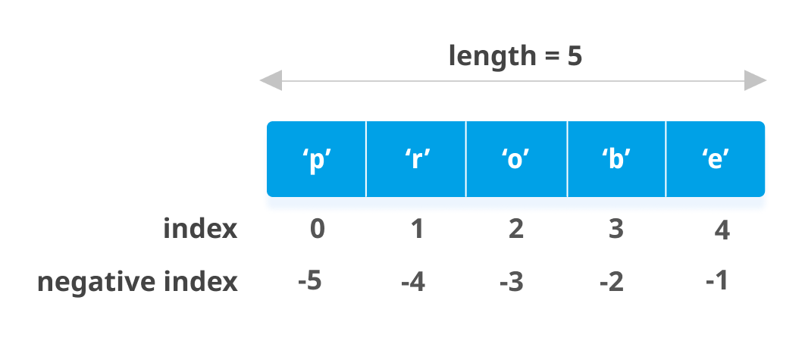
Python Lists
The list is created using the square brackets [].
actors = ["Jack Nicholson", "Antony Hopkins",
"Adrien Brody"]
Python lists are mutable
Python lists can hold mixed types
list = [11, "hello", -3.14, 23]
List items can be accessed by index:
first_name = actors[0] # first_name = "Jack Nicholson"
last_name = actors[-1] # lst_name = "Adrien Brody"
Notes:
Let’s assume we wish to write a program that swaps the contents of two Label.
Can we do it without using a third element?
It is possible but somewhat awkward to swap two elements without another in the middle.
So we need some variable to hold the contents of the first Label save it so that we can put it into the other Label.
This is an example of the need for a variable to hold data.
We can manipulate the variable content in order to perform more complex operations.

Slide 36
Python Lists Operators
+ Concatenation
* Repetition
[] Slice
[:] Range Slice
in/not in Membership
del Delete List Elements Or entire list
l1 = [1,3,5,7] l2 = l1 + [9,11] # l2 = [1,3,5,7,9,11] l3 = l1 * 2 # l3 = [1,3,5,7,1,3,5,7] 5 in l1 # returns True l1[2] = 6 # l1 = [1,3,6,7] print( l1[0:2]) # prints: [1,3] del l1[2] # l1 = [1,3,7] del l3[1:7] # l3 =[1,7]
Notes:
Let’s assume we wish to write a program that swaps the contents of two Label.
Can we do it without using a third element?
It is possible but somewhat awkward to swap two elements without another in the middle.
So we need some variable to hold the contents of the first Label save it so that we can put it into the other Label.
This is an example of the need for a variable to hold data.
We can manipulate the variable content in order to perform more complex operations.

Slide 37
Python Lists Operators – cont'd
values = [1, 3, 5, 7, 9, 11, 13] print( values[:]) # prints all, like print(values) print( values[1:]) # prints all except first element print( values[:1] ) # prints only first element print( values[2:4]) # prints values at index 2 and 3 del values[:] # deletes all list values, values = [] del values # undefined list, list doesn't exists now print( values) # generates an error, the list is # longer exists
Notes:
Let’s assume we wish to write a program that swaps the contents of two Label.
Can we do it without using a third element?
It is possible but somewhat awkward to swap two elements without another in the middle.
So we need some variable to hold the contents of the first Label save it so that we can put it into the other Label.
This is an example of the need for a variable to hold data.
We can manipulate the variable content in order to perform more complex operations.

Slide 38
Python Lists Methods
Add/ Remove elements:
list.append(obj) – appends obj to the list
list.extend(seq) – appends seq to the list
list.insert(index, obj) – inset obj to the list at index index
list.pop() - removes and returns last object from list
list.remove(obj) – removes obj from list
lst = ["a","b","c","d"] last_elm = lst.pop() # last_elm = "d" print( lst) # lst = ["a","b","c"] lst.insert(2,"new") # lst = ["a","b","new","c"]
Notes:
Let’s assume we wish to write a program that swaps the contents of two Label.
Can we do it without using a third element?
It is possible but somewhat awkward to swap two elements without another in the middle.
So we need some variable to hold the contents of the first Label save it so that we can put it into the other Label.
This is an example of the need for a variable to hold data.
We can manipulate the variable content in order to perform more complex operations.

Slide 39
Python Lists Methods – cont'd
Reorganize functions:
list.sort() – sorts list items, IN PLACE
Sort function can receive call-back to specify custom sort order and attributes (will be discussed later)
list.reverse() – reverse the order of list items, IN PLACE
list.index(obj) – returns first index of obj in list, -1 otherwise
list.count(obj) – returns the number of times obj appears in list
Example:
lst = ["c","b","a","d"] lst.reverse() #lst = ["d", "a","b", "c"] lst.sort() #lst = ["a","b","c","d"]
Notes:
Let’s assume we wish to write a program that swaps the contents of two Label.
Can we do it without using a third element?
It is possible but somewhat awkward to swap two elements without another in the middle.
So we need some variable to hold the contents of the first Label save it so that we can put it into the other Label.
This is an example of the need for a variable to hold data.
We can manipulate the variable content in order to perform more complex operations.

Slide 40
Iterating Lists
Iterating values
for elm in li:
print( elm)
Iterating indexes:
li = ['a', 'b', 'c', 'd', 'e']
for i in range(len(li)):
print( li[i])
Notes:
Let’s assume we wish to write a program that swaps the contents of two Label.
Can we do it without using a third element?
It is possible but somewhat awkward to swap two elements without another in the middle.
So we need some variable to hold the contents of the first Label save it so that we can put it into the other Label.
This is an example of the need for a variable to hold data.
We can manipulate the variable content in order to perform more complex operations.

Slide 41
Lists comprehension
Lists comprehension used to construct new list from existed sequence in a very natural, easy way
l1 = range(1,11) #l1 = [1,2,3,4,5,6,7,8,9,10] list = [i*2 for i in l1] #list = [2,4,6,8,10,12,14,16,18,20] l2 = ["ab", "cd", "xyz"] print ([str(x) + str(x)[::-1] for x in l2]) # ["abba", "cddc", "zyzzyx"] L3 = [char for char in "python"] #l3 = ['p', 'y', 't', 'h', 'o', 'n'] l4 = [char for string in l2 for char in string] # ['a', 'b', 'c', 'd', 'x', 'y', 'z']
Notes:
Let’s assume we wish to write a program that swaps the contents of two Label.
Can we do it without using a third element?
It is possible but somewhat awkward to swap two elements without another in the middle.
So we need some variable to hold the contents of the first Label save it so that we can put it into the other Label.
This is an example of the need for a variable to hold data.
We can manipulate the variable content in order to perform more complex operations.

Slide 42
Labs Lists

Slide 43
Python Tuples
A tuple is index based sequence, just like list.
Python tuples are enclosed in parentheses ( )
Tuples are immutable and cannot be updated.
Tuples can be thought of as read-only lists
Tuples they more effective that lists
For example:
tuple = ( "abcd", 786 , 2.23, "john", 70.2 )
Notes:
Let’s assume we wish to write a program that swaps the contents of two Label.
Can we do it without using a third element?
It is possible but somewhat awkward to swap two elements without another in the middle.
So we need some variable to hold the contents of the first Label save it so that we can put it into the other Label.
This is an example of the need for a variable to hold data.
We can manipulate the variable content in order to perform more complex operations.

Slide 44
Tuples can’t be changed
tup = ("a", "b", "c", "d")
del tup[1] # generates an error
tup[0] = "e" # generates an error
But reassignment is supported:
tup = (1, 2, 3) #correct
Notes:
Let’s assume we wish to write a program that swaps the contents of two Label.
Can we do it without using a third element?
It is possible but somewhat awkward to swap two elements without another in the middle.
So we need some variable to hold the contents of the first Label save it so that we can put it into the other Label.
This is an example of the need for a variable to hold data.
We can manipulate the variable content in order to perform more complex operations.

Slide 45
Tuples Operators
Tuples have the same operators as lists and they behave the same:
+, *, [], [:], in/not in, Unpack assignment
Example 1:
Example 2:
tup = (1, 2, 3, 4, 5, 6, 7 ) res_tup = tup[1:5] # res_tup = (2,3,4,5)
tup1 = ("12", "234") tup2 = ("34", "567", "8") tup3 = tup1 + tup2 # tup3 = ("12", "234", "34", "567", "8")
Notes:
Let’s assume we wish to write a program that swaps the contents of two Label.
Can we do it without using a third element?
It is possible but somewhat awkward to swap two elements without another in the middle.
So we need some variable to hold the contents of the first Label save it so that we can put it into the other Label.
This is an example of the need for a variable to hold data.
We can manipulate the variable content in order to perform more complex operations.

Slide 46
Labs Tuples

Slide 47
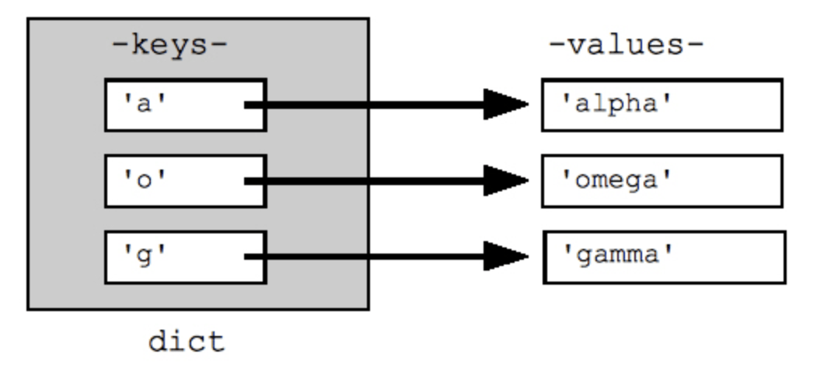
Python Dictionary
Python's dictionaries are kind of hash table that can be found in lots of different programming languages
Dictionaries consist of key-value pairs.
Dictionaries are enclosed in curly braces { }
Dictionary values have no restrictions. They can be any built-in or user-defined type
There are two important points to remember about dictionary keys:
Keys must be immutable (for built ins) or hashable (for user-defined)
no duplicate key is allowed. When duplicate keys encountered during assignment, the last assignment wins
A dictionary is mutable type
Notes:
Let’s assume we wish to write a program that swaps the contents of two Label.
Can we do it without using a third element?
It is possible but somewhat awkward to swap two elements without another in the middle.
So we need some variable to hold the contents of the first Label save it so that we can put it into the other Label.
This is an example of the need for a variable to hold data.
We can manipulate the variable content in order to perform more complex operations.

Slide 48
Python Dictionary – cont'd
Python dictionaries have they own internal keys organization, this is why the order of its items(pairs) is unpredictable and should be treated like "random"
dict = {'Name': 'Zara', 'Age': 7, 'Name': 'Manni'}
print(dict) #prints dict = {'Age': 7, 'Name': 'Manni'}
Values can be assigned and accessed using square braces [] for keys
When non-existed key is assigned with a value, this key-value pair is added to dictionary
When existed key is assigned with a value, its value is updated
When access non-existed key, the error is generated
Notes:
Let’s assume we wish to write a program that swaps the contents of two Label.
Can we do it without using a third element?
It is possible but somewhat awkward to swap two elements without another in the middle.
So we need some variable to hold the contents of the first Label save it so that we can put it into the other Label.
This is an example of the need for a variable to hold data.
We can manipulate the variable content in order to perform more complex operations.

Slide 49
Python Dictionary – examples
Create and Updating dictionary
Way 1: step by step creation
Way 2: all at once creation
dict = {} # empty dictionary dict["one"] = "value of one" # add new pair: "one"- "value of one" dict[2] = "value of 2" # add new pair: 2- "value of 2"
dict1= {"name": "john", "lastName":"Smith", "age": 33} dict1["age"] = 23 # updating value at key "age" print( dict1["AGE"] ) # generats KeyError
Notes:
Let’s assume we wish to write a program that swaps the contents of two Label.
Can we do it without using a third element?
It is possible but somewhat awkward to swap two elements without another in the middle.
So we need some variable to hold the contents of the first Label save it so that we can put it into the other Label.
This is an example of the need for a variable to hold data.
We can manipulate the variable content in order to perform more complex operations.

Slide 50
Python Dictionary – cont'd
Delete Dictionary Elements:
You can either remove individual dictionary elements, clear the entire contents of a dictionary or delete entire dictionary in a single operation.
dict= {"name": "john","lastName":"Smith", "age": 33} del dict["name "] # remove entry with key "name " dict.clear() # remove all entries del dict # delete entire dictionary
Notes:
Let’s assume we wish to write a program that swaps the contents of two Label.
Can we do it without using a third element?
It is possible but somewhat awkward to swap two elements without another in the middle.
So we need some variable to hold the contents of the first Label save it so that we can put it into the other Label.
This is an example of the need for a variable to hold data.
We can manipulate the variable content in order to perform more complex operations.

Slide 51
Python Dictionary – cont'd
The following methods defined for dictionary:
len(dic) – returns the number of key-value pairs
dict.clear() - removes all elements of dictionary dict
dict.get(key,[default for non-existed key]) - for key key, returns its value or default if key doesn’t not exists. Default value for default is None
dict.items() -returns a list of dict's (key, value) tuple pairs
dict.keys() -returns list of dictionary dict's keys
dict.values() -returns list of dictionary dict's values
Notes:
Let’s assume we wish to write a program that swaps the contents of two Label.
Can we do it without using a third element?
It is possible but somewhat awkward to swap two elements without another in the middle.
So we need some variable to hold the contents of the first Label save it so that we can put it into the other Label.
This is an example of the need for a variable to hold data.
We can manipulate the variable content in order to perform more complex operations.

Slide 52
Python Dictionary – cont'd
The Output:
Key-Values pairs : [('last_name', 'Smith'), ('age', 33), ('name', 'john')]
dict= {"name": "john", "last_name":"Smith", "age": 33} print( dict["AGE"]) # generates KeyError print( dict.get("AGE")) # prints None print( dict.get("AGE", -1)) # prints -1 print( dict.keys() # prints ['last_name', 'age', 'name'] print( "Key-Values pairs : {}".format(dict.items())
Notes:
Let’s assume we wish to write a program that swaps the contents of two Label.
Can we do it without using a third element?
It is possible but somewhat awkward to swap two elements without another in the middle.
So we need some variable to hold the contents of the first Label save it so that we can put it into the other Label.
This is an example of the need for a variable to hold data.
We can manipulate the variable content in order to perform more complex operations.

Slide 53
Iterating Through a Dictionary
d = {'x': 1, 'y': 2, 'z': 3}
Iterating keys:
for key in d.keys():
print( key, d[key])
The Output:
y, 2
x, 1
z, 3
Iterating items:
for k, v in dict.items():
print( "{}, {}".format (k, v))
Notes:
Let’s assume we wish to write a program that swaps the contents of two Label.
Can we do it without using a third element?
It is possible but somewhat awkward to swap two elements without another in the middle.
So we need some variable to hold the contents of the first Label save it so that we can put it into the other Label.
This is an example of the need for a variable to hold data.
We can manipulate the variable content in order to perform more complex operations.

Slide 54
Iterating Through a Dictionary – cont’d
Iterating values:
dict= {"name": "john", "last_name":"Smith", "age": 33}
print( "\n".join(["%s=%s" % (k, v) for k, v in dict.items()]))
The output:
Last_name=Smith
age=33
name=john
Notes:
Let’s assume we wish to write a program that swaps the contents of two Label.
Can we do it without using a third element?
It is possible but somewhat awkward to swap two elements without another in the middle.
So we need some variable to hold the contents of the first Label save it so that we can put it into the other Label.
This is an example of the need for a variable to hold data.
We can manipulate the variable content in order to perform more complex operations.

Slide 55
Dictionary comprehension
Dictionary comprehension supported in python starting from python 2.7
keys = [1,2,3]
values=[4,5,6]
dict = {keys[i]:values[i] for i in range(len(keys))}
print(dict) # {1: 4, 2: 5, 3: 6}
d1 = {k: 0 for k in ['a','b','c']} # {'a': 0, 'c': 0, 'b': 0}
d2 = {n: n**2 for n in [10, 11, 12]} #{10:100, 11:121, 12:144}
Notes:
Let’s assume we wish to write a program that swaps the contents of two Label.
Can we do it without using a third element?
It is possible but somewhat awkward to swap two elements without another in the middle.
So we need some variable to hold the contents of the first Label save it so that we can put it into the other Label.
This is an example of the need for a variable to hold data.
We can manipulate the variable content in order to perform more complex operations.

Slide 56
Labs Dictionary

Slide 57
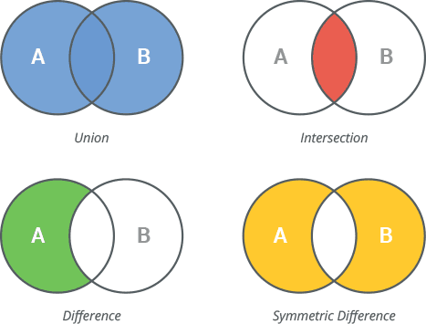
Set’s
Set is unordered collections of unique elements
Common uses:
– Removing duplicates from a sequence
– Intersection
– Union
– Difference
– etc
Use {……} to define set --> 1,5,2,8,0
Use set() to define an empty set
my_set = {1 , 77, 4 , 81 , 10 , 77 , 4} print( my_set ) # 81 , 10 , 1 , 4 , 77
Notes:
Let’s assume we wish to write a program that swaps the contents of two Label.
Can we do it without using a third element?
It is possible but somewhat awkward to swap two elements without another in the middle.
So we need some variable to hold the contents of the first Label save it so that we can put it into the other Label.
This is an example of the need for a variable to hold data.
We can manipulate the variable content in order to perform more complex operations.

Slide 58
Set’s functions
st.issubset(t) test whether every element in st is in t
s.issuperset(t) test whether every element in t is in st
s.union(t) return new set with elements from both s and t
s.intersection(t) return new set with elements common to s and t
s.difference(t) return new set with elements in s but not in t
s.symmetric_difference(t) return new set with elements in either s or t but not both
s.update(t) update set s with elements added from t
s.difference_update(t) update set s after removing elements found in t
s.add(x) add element x to set s
s.discard(x) removes x from set s if present
s.clear() remove all elements from set s
Notes:
Let’s assume we wish to write a program that swaps the contents of two Label.
Can we do it without using a third element?
It is possible but somewhat awkward to swap two elements without another in the middle.
So we need some variable to hold the contents of the first Label save it so that we can put it into the other Label.
This is an example of the need for a variable to hold data.
We can manipulate the variable content in order to perform more complex operations.

Slide 59
Set’s functions examples
items = set() items.add("cat") items.add("dog") items.add("gerbil") print(items) # {'gerbil', 'dog', 'cat'} s1 = {1,2,4,5,6} s2 = {2,3,5,7,8} s2.update(s1) print (s2) #{1, 2, 3, 4, 5, 6, 7, 8}
Notes:
Let’s assume we wish to write a program that swaps the contents of two Label.
Can we do it without using a third element?
It is possible but somewhat awkward to swap two elements without another in the middle.
So we need some variable to hold the contents of the first Label save it so that we can put it into the other Label.
This is an example of the need for a variable to hold data.
We can manipulate the variable content in order to perform more complex operations.

Slide 60
Set’s functions examples – cont’d
s1 = {1,3,4} s2 = {4,5,6} s3 = {4,3,2,1,0} print(s1.issubset(s3)) # True print(s1.issubset(s2)) # False print (s1.union(s2)) # {1, 3, 4, 5, 6} print (s1,s2) # {1, 3, 4} {4, 5, 6} print (s1.intersection(s2)) # {4} print (s1.difference(s2)) # {1, 3}
Notes:
Let’s assume we wish to write a program that swaps the contents of two Label.
Can we do it without using a third element?
It is possible but somewhat awkward to swap two elements without another in the middle.
So we need some variable to hold the contents of the first Label save it so that we can put it into the other Label.
This is an example of the need for a variable to hold data.
We can manipulate the variable content in order to perform more complex operations.

Slide 61
Labs Sets

Slide 62
Mutable vs Immutable in Python
An immutable variable is an object whose value can't be modified after it is created
If change of immutable variable is supported, the change will always create a new, updated value
Python immutable type are: None, bool, int, long (if exist), complex, string, tuple
Python mutable types are: list, dictionary, set, classes
Notes:
Let’s assume we wish to write a program that swaps the contents of two Label.
Can we do it without using a third element?
It is possible but somewhat awkward to swap two elements without another in the middle.
So we need some variable to hold the contents of the first Label save it so that we can put it into the other Label.
This is an example of the need for a variable to hold data.
We can manipulate the variable content in order to perform more complex operations.

Slide 63
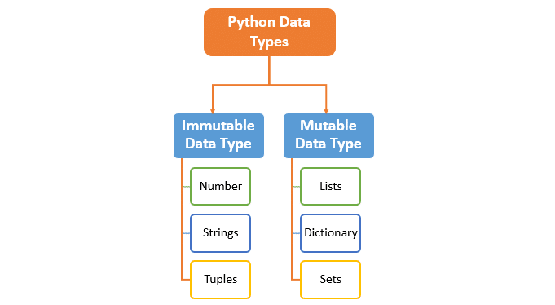
Mutable vs Immutable in Python – cont’d
Look at the following code:
l1 = [11, 22, 33]
l2 = l1;
l1.append(44)
print( l2)
What is the output for this code?
Notes:
Let’s assume we wish to write a program that swaps the contents of two Label.
Can we do it without using a third element?
It is possible but somewhat awkward to swap two elements without another in the middle.
So we need some variable to hold the contents of the first Label save it so that we can put it into the other Label.
This is an example of the need for a variable to hold data.
We can manipulate the variable content in order to perform more complex operations.

